Slide 1
Week 6
NFTs and the Stellar Ecosystem
Stellar Technical Academy

Slide 2
Session 6: Agenda
Non-Fungible-Tokens
NFTs and the Stellar Ecosystem
What is the Metaverse
Conclusion
Session 06: Theory

Slide 3
Session 6: Objectives
In this final week of the Stellar Technical Academy, you will:
Learn what a Non-Fungible-Token (NFT is)
Discover the Metaverse and have a look in its first prototypes
Understand how NFTs and the Metaverse complement each other
Find out about Stellar’s NFT marketplace and overall activity on NFTs
Session 06: Theory

Slide 4
1. Non-Fungible-Tokens

Slide 5
Non-Fungible-Tokens
What NFTs are?
An NFT (Non-Fungible-Token) is a digital representation of information or data that constitutes proof of ownership. It is a token that represents a unique asset with particular characteristics.
NFTs let us tokenise things like art, videos, collectibles, music, domain names and even real estate and can be bought with cryptocurrency or traditional currency.
As the term ‘non-fungible’ suggests, they are unique, not mutually interchangeable and can not be replaced by another equivalent token. This means that, while you can exchange/replace 1 XLM for another 1 XLM, you definitely can not exchange/replace an NFT for another NFT. Moreover, NFTs can only have one official owner at a time. Thus, they allow an individual to show proof of a digital asset, which, as we will see later on, can prove to be very important.
But how do NFTs really work?
In a more technical view, an NFT, if registered on a blockchain, becomes truly a unique asset, since it can’t be counterfeited, tampered with or defrauded. Connecting NFTs with blockchain technology and securing them with a cryptographic key that can’t be deleted, copied or destroyed, brings certain standardized attributes, such as ownership, transfer and access control, as well as interoperability (allowing NFTs to move more easily between various ecosystems).
Session 06: Theory

Slide 6
Non-Fungible-Tokens
What NFTs are?
So, NFT ownership is managed through the unique ID and the metadata, that no other token can replicate.
Nowadays, most of the NFTs are secured by the Ethereum blockchain, assuring that:
No one can modify the record of ownership of an NFT, and
No one can copy and paste a new NFT into existence.
At first, NFTs are created; for example if we are talking about a jpeg, the creation refers to the creation of the artwork.
Then, much like what would happen with a cryptocurrency transaction, they are minted; the information is added to the blockchain, where the NFT is being managed.
From a high level, the minting process involves:
Creating a new block
Validating information
Recording the information into the blockchain
Session 06: Theory

Slide 7
Non-Fungible-Tokens
How can you use NFTs?
Some use-cases as example.
The fashion industry (Dolce & Gabbana) uses NFTs to connect real-world fashion with virtual fashion for the Metaverse.
The gaming industry uses NFTs in play-to-earn games, providing proof of ownership and control for digital assets (e.g., scarce items in a game).
In virtual worlds users can create and trade digital goods, and display their NFTs in galleries.
NFTs with smart contract functionality help to sell real estate in the Metaverse.
NFTs secure exclusive access for NFT holders to real world events and locations in the Metaverse.
Session 06: Theory

Slide 8
Non-Fungible-Tokens
How to handle NFTs?
The NFT metadata is stored in a decentralized Stellar wallet and can be traded on Stellar Decentralized Exchanges (SDEX).
Indeed, Litemint.io, a competitive tradable card game built on Stellar, launched its own NFT marketplace, Litemint.com, utilizing the network’s fiery speed and incredibly low transaction fees.
The low cost and high speed of minting on Stellar, is constantly drawing numerous artists, from other blockchains, towards the Litemint.com, especially when the other blockchains have much higher gas fees and take longer to complete the transaction (e.g., Opensea.io).
Additionally, Litemint.com will be integrating card, ACH (Automated Clearing House) and wire payments with USDC on Stellar.
Session 06: Theory

Slide 9
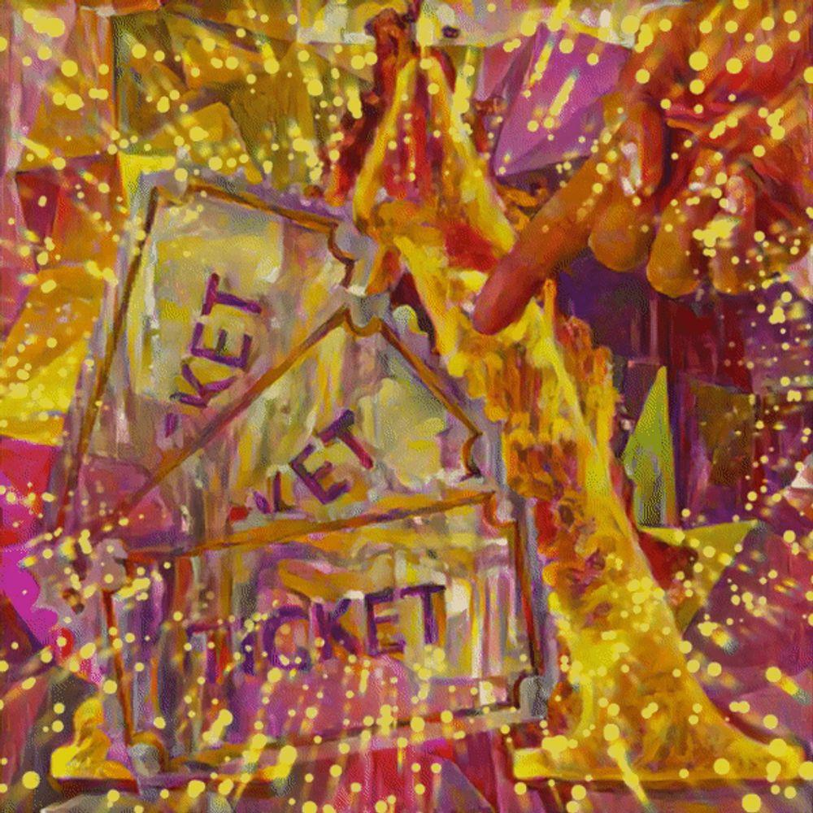
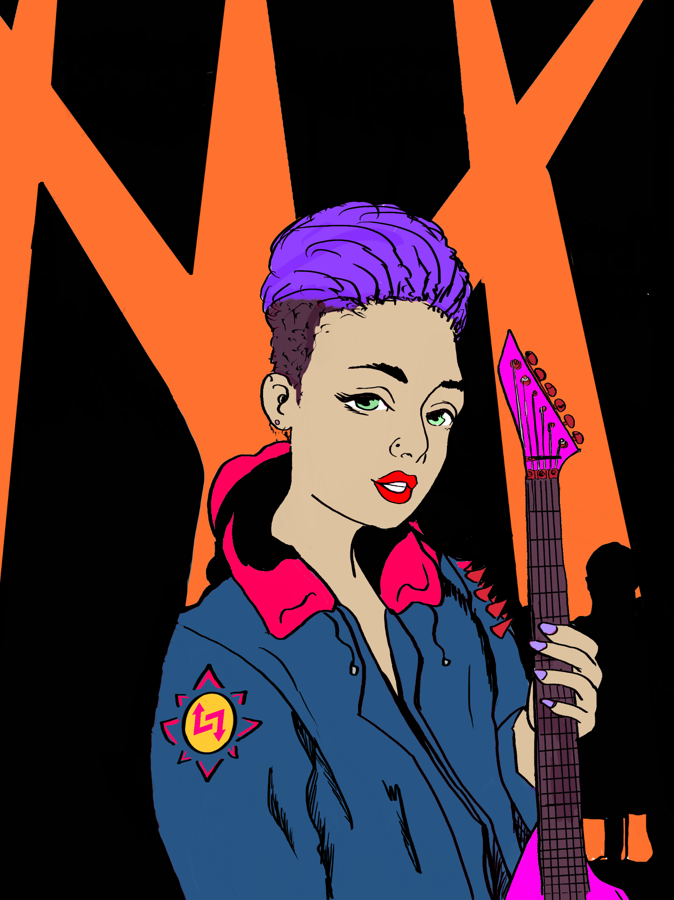
Non-Fungible-Tokens
How got NFT’s influenced by blockchain technology?
Finally, it is important to keep in mind that NFTs existed before blockchain, but blockchain technology has transformed NFT markets, by:
Solving the double-spending problem
Conferring scarcity
Conferring uniqueness, and
Conferring authenticity
AUCTION GOLDEN TICKET by Action Tokens on Litemint
Stella’s 006 by Andrew Draws on Litemint Marketplace
Session 06: Theory

Slide 10
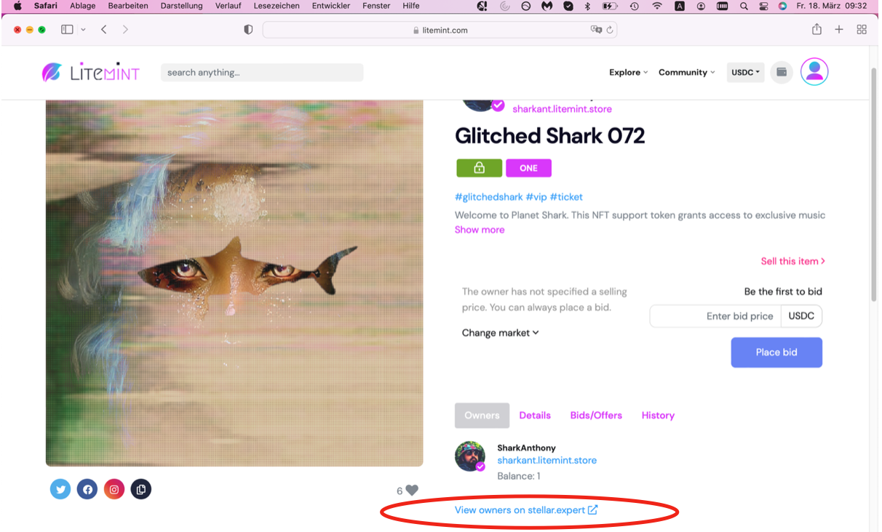
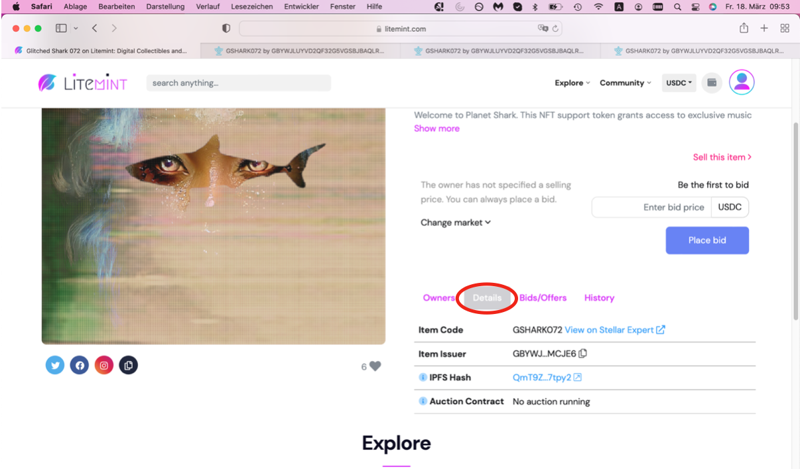
Non-Fungible-Tokens
How can you check the ownership of an NFT?
For validation of its ownership, you check an NFT’s metadata by accessing Litemint.com and clicking on the auction (see right image).
The tab owner shows the creator ‘SharkAnthony’ and link to the stellar.expert which is the blockchain explorer specifically for NFTs on the stellar blockchain.
The tab details shows the item code and the item issuer. The IPFS-hash means that the data is stored on the decentralized IPFS network with its content unique fingerprint (CID).
Please click the IPFS-hash.
Session 06: Theory

Slide 11
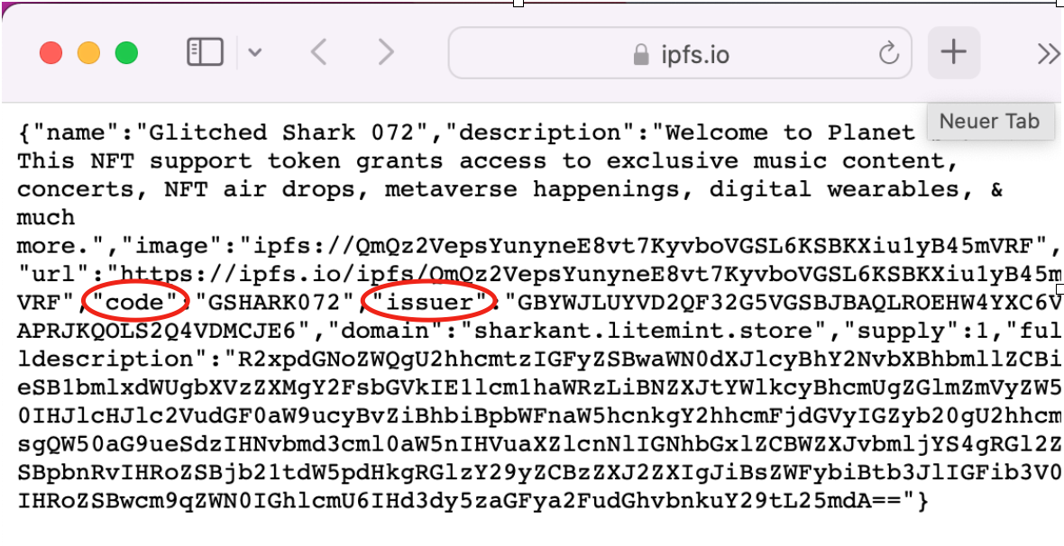
Non-Fungible-Tokens
How can you check the ownership of an NFT?
It will show you the asset code of the NFT and the issuer which should be unique for the issuing address.
Before you purchase an NFT and especially if you buy collectibles, you should make sure to buy only from official links and always check the metadata to avoid being deceived.
Since an IPFS URL is used, you will be able to check the data (picture, animation or video).
Session 06: Theory

Slide 12
2. NFTs and the Stellar Ecosystem

Slide 13
NFTs and the Stellar Ecosystem
What are the properties of NFTs on Stellar?
As we have already seen, some of the most prominent features of the Stellar network are:
Energy efficiency
Low transaction fees
High transaction speed, and
Decentralisation
These features make Stellar an ideal network for launching an NFT marketplace.
Indeed, Litemint.io, a competitive tradable card game built on Stellar, has launched for a while now its own NFT marketplace, Litemint.com, utilizing the networks fiery speed and incredibly low transaction fees.
The low cost and high speed of minting on Stellar, is constantly drawing numerous artists, from other blockchains, towards the Litemint.com, especially when the other blockchains have much higher gas fees and take longer to complete the transaction (e.g., Opensea.io on the Ethereum Mainnet).
Session 06: Theory

Slide 14
NFTs and the Stellar Ecosystem
What do NFTs and Smart Contracts on Stellar look like?
NFTs are powered by smart contracts, which handle the transferability and verify the ownership.
As we have mentioned in previous weeks, a smart contract is the backbone of complete decentralisation and it’s a program that runs on a blockchain.
The Ethereum blockchain was the first to use smart contracts.
The Stellar network, in order to keep its utterly decentralised character, uses its own smart contracts as well: the TSS (Turing Signing Servers) network, or the “turrets”.
The Stellar Turrets are
“A decentralized, smart contract protocol for the secure, cost-effective creation and signing of Stellar transactions”.
Basically, they introduce a new way for applications to create decentralised, permissionless applications on the Stellar blockchain, by adding a layer 2 solution for decentralising Turing complete smart contracting for Stellar transactions as well as adding a permissionless system for users to run smart contracts on.
What’s important to mention here, is that the smart contracts build and sign transactions, always in accordance with uploaded smart contract specifications at a user's request.
Session 06: Theory

Slide 15
NFTs and the Stellar Ecosystem
What is the marketplace Litemint?
One more important feature that Litemint.com excels at, compared to the other blockchains (especially Bitcoin and Ethereum), and thanks to the Stellar network, is that it is more energy efficient and sustainable.
Although, we recognise that this is an important advantage of the Stellar network and the Litemint.com marketplace, against other blockchains, the essence of this feature is best understood if we think of it the long-run, because:
“If blockchain technologies move forward as an integral part of the global economy, both in finance and art,
they must be environmentally responsible.”
You can find the source code of the Litemint marketplace here.
Additionally, Litemint.com has established the Litemint Blog, where it accommodates discussions about Litemint and tackles problems reported to the blog or any other source (e.g., Reddit).
Litemint.com offers a huge variety of video, audio and gaming NFTs.
Session 06: Theory

Slide 16
NFTs and the Stellar Ecosystem
What is SmartNFTs Drop?
In order to enforce its presence in the NFT marketplace scene, Stellar has launched the SmartNFTs drop.
The SmartNFTs initiative aims to explore interesting payment mechanics on the decentralised layer 2 smart contract protocol, Stellar Turrets.
In order to do so, the drop consists of three (3) NFTs artworks so far, where each one is accompanied by a challenge/ experimental game.
SmartNFT00 is called ‘Escalated Royalties’. The idea is to create an NFT, where its value increases over time. If the NFT is sold, the previous owner does not receive the full amount of the sale price; instead, an algorithm pays every previous owner proportionally.
SmartNFT01 ‘The Dig’ consists of three unique phases: dig, mint and issue. All the NFTs from this batch are sequentially dependent and in the same smart contract. For the mint of the final form, all the 40 x 40 =1600 individual pixels have to be digged to mint the final NFT. You can buy a minimum of 10 pixels for 10 XLM (1600/10 = 160) and a maximum of 20 pixels (1600/20 = 80) for 200 XLM. This results in a SmartNFT01 supply from 80 to 160 SmartNFTs. Dig all the pixels and mint the final SmartNFT01. Once you digged all the SmartPlotNFT and SmartNFT01 you will be able to sell, trade, swap and burn at any StellarDEX.
Session 06: Theory

Slide 17
NFTs and the Stellar Ecosystem
What is SmartNFTs Drop?
SmartNFT02 named ‘White Elephant, Dark Lord’. It‘s always for sale as a 1 of 1 and always for 5 USDC. You can steal the dark lord from other participants’ wallets; therefore you get the reward of other dark thieves. This mechanism has the purpose of avoiding hoarding of art and increasing the demand steadily. The wallet which holds the most Dark Lord thieves on Christmas morning in 2022 will get the final Dark Lord NFT fully unlocked.
Anyone interested can take on the challenges, which aim to lead to innovative solutions and/or enhancements of the Stellar smart contract protocol.
At the end of some of the experimental games, the winner can be rewarded with an amount of XLMs.
If you are interested in participating, or just want to have a look at the challenges, you can find them here.
Session 06: Theory

Slide 18
3. What is the Metaverse

Slide 19
NFTs and the Metaverse
What is the Metaverse?
Trying to understand today what the Metaverse is, is pretty much like trying to understand what the Internet was in the 1970’s.
The explosion in the development of blockchain-based metaverses is strictly related to the explosive growth of the Non-Fungible Tokens (NFTs) space and vice versa.
But what really is the Metaverse?
It is expected to be an always-on digital universe, where the users are embodied. Every single item from the physical world and every interaction takes place in digital form.
It can be assumed that the Metaverse will be the next generation of the Internet. The key elements are virtual reality (VR), augmented reality (AR), as well as IoT devices and holograms.
Both technologies provide an immersive user experience. AR allows the user to observe their environment with attractive digital visuals like it is used in Pokémon GO. On the other hand, VR creates a computerized digital world that is discovered with VR headsets, gloves and digital sensors.
For the transformation of real-world objects 3D scanners are used.
Session 06: Theory

Slide 20
NFTs and the Metaverse
What is the Metaverse?
Artificial Intelligence (AI) is another technology which is already widely used in our daily lives. In the Metaverse AI processes and manages data easier and faster. This is crucial because the Metaverse processes become more dynamic and the user experience will be enhanced. Even though 3D scanners are used to create a 3D image, the AI helps to generate more realistic avatars and align them with the real participants.
The Internet of Things (IoT) is a bridge from the physical world to the digital world that contributes to providing data with sensors. The IoT will connect the virtual 3D world to real-world devices and will enable the connection of real-world processes in digital infrastructure.
There are some prototype next-generation metaverses, such as Decentraland, Somnium Space and Bloktopia that lead the way of true digital societies, with individuals settling land, interacting socially, exchanging goods and asserting ownership rights.
After navigating to any of the Metaverse prototypes above, anyone can ascertain that the Metaverse is basically:
“The convergence of two ideas that have been around for many years: virtual reality and a digital second life.”
Session 06: Theory

Slide 21
NFTs and the Metaverse
What can you expect from the Metaverse?
A typical day in the Metaverse will closely resemble the familiar world we live in. We will be able to visit virtual shopping centers, drive across towns, meet friends in cafes, and exchange contacts in ways that seem strikingly real – thanks to rapid advances in virtual reality and 5G communications.
Although the Metaverse is still very nascent, there are already many brands that are establishing their presence and migrating parts of their economy there.
The Metaverse will open new business opportunities for example:
B2B Crypto Businesses like Solana and traditional companies like the HSBC Bank entered the Metaverse with digital headquarters where the employers and employees will meet and collaborate
B2C cross-border and cross-Metaverse foreign exchange and liquidity solutions
C2C Exchange of virtual goods via NFTs
As we can see, brands and retailers connect with the Metaverse to deliver innovative and unique retail experience to the audience.
Session 06: Theory

Slide 22
NFTs and the Metaverse
What is the relationship between Blockchain-technology and the Metaverse?
While metaverses existed way before blockchain, it is the blockchain technology that offers a layer in the metaverses which allows trade and ownership of digital assets and the existence of a virtual economy within these linked worlds.
With blockchain technology and NFTs the transfer of value is very safe, secure and easy.
Blockchain can enable compatibility between different metaverses. It will provide the element of interoperability, for example with projects such as Polkadot which allows users to create customized blockchains. These blockchains can interact with each other.
As in the real world, we need rules for the Metaverse. Blockchain is the ideal foundation to facilitate fair and transparent governance rules in the Metaverse.
Cuy Sheffield, Head of Crypto at Visa acquired Anchorage Cryptopunk 7610. Furthermore, he made the statement ”We envision there could be a future where your wallet address becomes as important as your mailing address”.
With Mr. Sheffield’s statement it becomes quite clear that a payment service provider wants to integrate blockchain technology and the Metaverse by purchasing NFTs.
The manifold opportunities for companies to join this digital ecosystem to facilitate new business strategies and open the scope of possibilities that can not be measured, yet.
Session 06: Theory

Slide 23
NFTs and the Metaverse
Why are the NFTs the building blocks of the Metaverse?
NFTs help to overcome the boundaries between the physical world and the worlds that exist inside digital devices.
Therefore, NFTs are the building blocks of the Metaverse.
Your digital NFT collectibles interact with the Metaverse. You can use them in virtual spaces in your application and see them through an augmented reality (AR) mobile app. The app shows you how they will look in real life.
NFTs are already representing a new virtual economy with the opportunity of buying, selling, trading and exchanging digital items.
In the Metaverse NFTs will represent the ownership of every good, plot of land and vehicle. The NFTs will be saved in your crypto wallet and even if you lose them, with your private key the ownership of your assets or activities can be proved through the blockchain.
Session 06: Theory

Slide 24
NFTs and the Metaverse
Why are the NFTs the building blocks of the Metaverse?
“NFTs are the digital key to unlocking the metaverse”, Shreyansh Singh, the head of Polygon's NFT and gaming arm, wrote in a Decrypt article.
"That was kind of the missing piece of the puzzle, now that that's enabled, the metaverse is actually coming to fruition" said Steinwold, who's also a managing partner of NFT-focused firm Sfermion, in the Market Insider.
As much as any physical society, the Metaverse needs an economy too.
In this case, the economy depends on securing one’s virtual identity and digital possessions, such as one’s Metaverse car, home, clothing, furniture, etc., for a Metaverse society to succeed and interact with other Metaverse societies.
Session 06: Theory

Slide 25
NFTs and the Stellar Ecosystem
Why are the NFTs the building blocks of the Metaverse?
But how can a Metaverse economy be sustained and flourish?
Enter: NFTs!
The Metaverse and NFTs have come to be almost analogous and this was initiated by the explosion of NFTs in blockchain gaming.
All the real-life identities and the digital possessions that will exist in the Metaverse, will be tied to digital avatars, which will hold the form of NFTs.
By being more precise the NFT avatar represent a real person which can be used in multiple metaverses.
The NFTs serve as extension of identity and offer numerous potential for community and social experiences.
Proof of one’s ownership of a digital asset will be vital in the Metaverse and the NFTs provide just that.
However, in order for this digital economy to flourish, the ability to travel and trade freely between realms that might have different laws and rules will be needed.
Session 06: Theory

Slide 26
NFTs and the Stellar Ecosystem
Why are the NFTs the building blocks of the Metaverse?
Moreover, it is also important that there won’t be any more need for games to create their own currency, since NFTs can be purchased with cryptocurrency or traditional currency.
The combination of these two technological innovations is already starting to create the most robust and advanced digital economy the world has ever seen.
Session 06: Theory

Slide 27
4. Conclusion

Slide 28
Conclusion
Key learnings
An NFT represents a single specific digital asset on the blockchain which can not be replicated. An NFT can be intangible (like a JPEG, MP3 file, etc.) or tangible (like real estate, a painting, etc.) that is digitized.
These non-interchangeable valuables all have their own individual value characterised by their unique ID and metadata which is stored on the blockchain.
The Metaverse is not the Internet you look at but rather is immersive – you participate and move in it. Technologies such as VR and AR are used, as we already know them from gaming.
The Metaverse is still in its infancy but with great business use-cases; therefore it will grow rapidly.
Litemint.com which operates on the Stellar network, allows users to create and mint NFTs at low fees and high transaction speed.
Environmentally friendly consensus mechanisms are appreciated by many, therefore Stellar has a good chance to grow its NFT Marketplace Litemint.com in the future.
Session 06: Theory

Slide 29
References

Slide 30
References
https://medium.com/stellar-community/nfts-in-the-stellar-ecosystem-2ec14c8b9ee2
https://turrets.stellar.org/
https://github.com/stellar/stellar-turrets-docs
https://nft.kalepail.com/
https://www.rennoco.com/post/nfts-minting-and-copyright-what-you-should-know-as-an-artist#:~:text=When%20you%20decide%20to%20create,token%20to%20guarantee%20its%20authenticity
https://markets.businessinsider.com/news/currencies/facebook-metaverse-nfts-crypto-meta-cryptocurrencies-2021-11
https://www.ft.com/partnercontent/crypto-com/nfts-the-metaverse-economy.html
https://decrypt.co/82992/nfts-key-accessing-metaverse-beyond
https://www.nytimes.com/2021/10/04/style/dolce-gabbana-nft.html
https://medium.com/stellar-community/best-practices-for-creating-nfts-on-stellar-5c91e53e9eb9
https://stellar.global/insights/stellar-series-welcome-to-the-metaverse/
Session 06: Theory

Slide 31
If you are a student, developer, startup or a full-fledged company and you want to build on Stellar and get your idea funded, visit the Stellar Community Fund !
If you are want to become a Stellar Tech ambassador or a Stellar Campus Expert visit the Stellar Advocates Page !

Slide 32
Questions?
Contact Us: Stellar Developers Discord
Twitter: @StellarOrg

